Slide 1


Predicting Hospital Bed Occupancy Rates
A machine learning solution for healthcare resource management. Revolutionizing hospital capacity planning. Addressing the economic impact of sleep deprivation by improving resource allocation.
by Prashant Mani Tripathi
Naveen
G Sharath

Slide 2

The Hospital Bed Occupancy Challenge
Hospitals often face critical bed shortage periods.
Emergency departments deal with significant overcrowding.
Bed Shortages
Overcrowding
90% of hospitals experience critical bed shortage periods.
Emergency departments face 35-40% overcrowding.
Ineffective Forecasts
Traditional methods fail to capture complex patterns.

Slide 3
Machine Learning: A Game-Changing Approach
Machine learning offers a transformative solution.
Data-Driven
External Factors
Accuracy
Utilizes historical admission and release data.
Incorporates holidays and seasonal variations.
Predictive accuracy within 6.24% mean absolute error.

Slide 4

Data Sources and Collection
We leverage comprehensive data for accurate predictions.
Electronic Health Records
Primary data source for patient information.
Historical Datasets
5-year historical patient encounter datasets.
Anonymized Data
No personal patient information is used.
Multiple Data Points
Admissions, discharges, and ward types included.

Slide 5
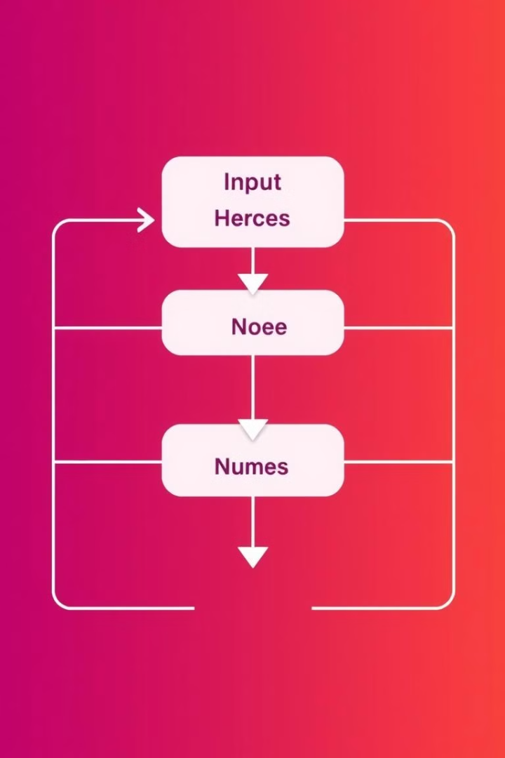



Machine Learning Model Architecture
Our model combines advanced algorithms for optimal results.
Random Forest
Random Forest for core prediction.
Decision Tree
Decision Tree for classification.
XGBoost
XGBoost for enhanced predictive capabilities.

Slide 6
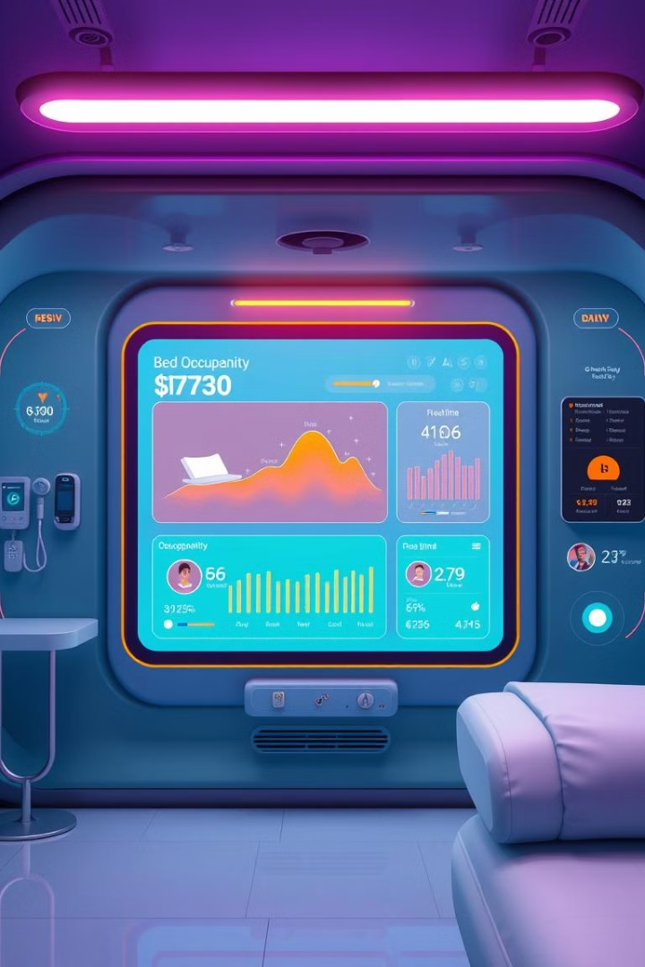




Predictive Capabilities
Our system delivers accurate, timely predictions.
Occupancy Forecast
Forecast bed occupancy 1-2 days in advance.
Admission Accuracy
80% accuracy in patient admission predictions.
Real-Time Monitoring
Real-time monitoring of bed availability.
Discharge Prediction
Predicts expected discharge times.

Slide 7
Operational Benefits
Our solution streamlines operations and improves efficiency.
Reduce Waiting Times
1
Minimize emergency department delays.
Optimize Staffing
2
Improve staff scheduling effectiveness.
Minimize Inefficiencies
3
Reduce bed allocation inefficiencies.

Slide 8
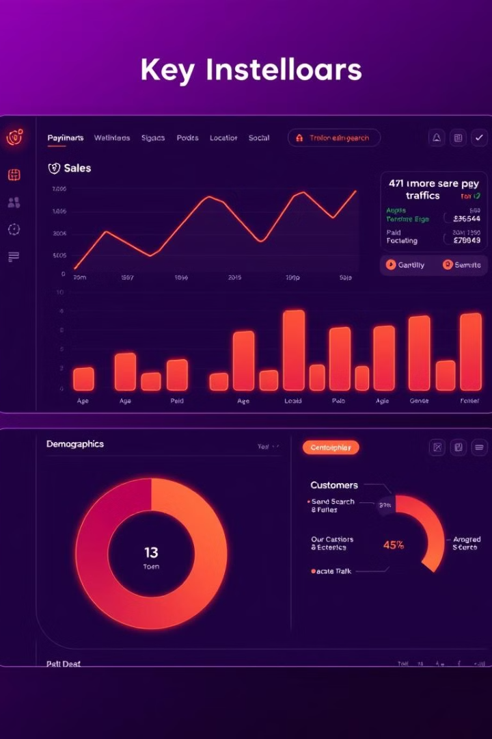
Technical Performance Metrics
We deliver high performance and accuracy.
4.0
0.82-0.90
Mean Absolute Error
AUROC
Low error rate in admissions forecasting.
High accuracy in predictions.
2s
Speed
Faster than human analysis.

Slide 9



Future Developments
We continue to innovate and expand our capabilities.
Enhanced Prediction
2
Improved real-time forecasting.
System Integration
1
Seamless integration with hospital systems.
Network Expansion
Deployment across multiple hospital networks.
3

Slide 10



Conclusion
Machine learning transforms hospital resource management.
Efficiency
1
Enhanced operational efficiency.
Patient Care
2
Improved patient care quality.
Innovation
3
A promising technology for healthcare.

